Slide 1

Construction of an Inoperability Input-Output Model (IIM) to Evaluate the Mindanao Power Crisis
Francesca Dianne B. Solis*¹, Krista Danielle S. Yu¹, Raymond R. Tan²
¹School of Economics, De La Salle University, 2401 Taft Avenue, 1004 Manila, Philippines
²Center for Engineering and Sustainable Development Research, De La Salle University, 2401 Taft Avenue, 1004 Manila, Philippines

Slide 2
Mindanao Power Crisis: The Problem
The Mindanao Power Crisis has plagued the country’s southernmost island with severe power interruptions that cause disruptions on the region’s economic activities.
Given that more than fifty percent (50%) of power generated in Mindanao is produced through hydroelectric plants, its energy sector is highly vulnerable to climate change-induced perturbations.
The persistent shortage of electricity among regions in the island has increased the urgency to resolve the issue at hand.

Slide 3
Mindanao Power Crisis: A Proposed Strategy
Decision makers need to account for the economic impacts of a power shortage in the island to the rest of the country.
Various recommendations to ease power disruptions to possibly allow the increase in economic capacity of Mindanao’s economic system have been made.
Such policies should also account for indirect effects of power losses on different economic sectors to ensure inclusive growth.

Slide 4
Research Objective
We develop a multiregional inoperability input-output model to analyze the power shortage resulting from climate change induced events in order to aid in formulating rational adaptation policies for Mindanao. Such policies should also account for indirect effects of power losses on different economic sectors.
Construct regional and interregional 12x12 matrices that would capture the importance of the electricity sector in light of climate change-induced perturbations.

Slide 5
Multiregional Inoperability Input-Output Analysis
The multiregional inoperability input-output model is an extension of the inoperability input-output models that accounts for spatial explicitness that the original IIM lacks.
Herein, multiregional coefficients are estimated using commodity and service flows not only within the region but also across regions and sectors, which accounts for spatial explicitness.

Slide 6
Multiregional Inoperability Input-Output Analysis: Significance of the Method
This allows analysis in the regional level that helps manage the larger system. This shows a more detailed analysis that starts in a smaller sub-level to the larger economic system.
This provides impacts as a result of a more concentrated perturbation on the economy will allow us to better manage risk. This allows management and strategic preparedness on a smaller and more concentrated scale that could better mitigate risks.

Slide 7
Multiregional Inoperability Input-Output Analysis:
The Framework
where
q = inoperability vector
T* = multiregional interdependency matrix
A* = IIM interdependency matrix
f* = perturbation vector

Slide 8
Multiregional Inoperability Input-Output Analysis:
The Framework
where
= square matrix with diagonal elements of the vector of total production output of each sector in each region
T = multiregional trade coefficient matrix

Slide 9
Multiregional Inoperability Input-Output Analysis:
The Framework
where
A = Leontief technical coefficients matrix

Slide 10
Multiregional Inoperability Input-Output Analysis:
The Framework
where
f = vector of final demand
= post-disaster level of final demand

Slide 11
Methodology
Estimation of 12x12 Regional Input-Output Tables
Estimation of trade coefficients utilizing the Basic Gravity Model
Construction of the Multiregional Inoperability Input-Output Tables
Computation of Sector Inoperability and Economic Losses at the regional level

Slide 12
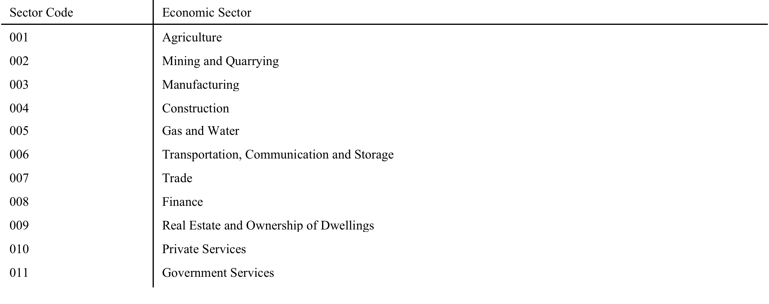
Data from the 2000 Philippine Input-Output Table
National Statistical Coordination Board, 2005

Slide 13
Case Study Scenario
10% Inoperability in the Electricity Sector in Region XII: SOCCSKSARGEN

Slide 14
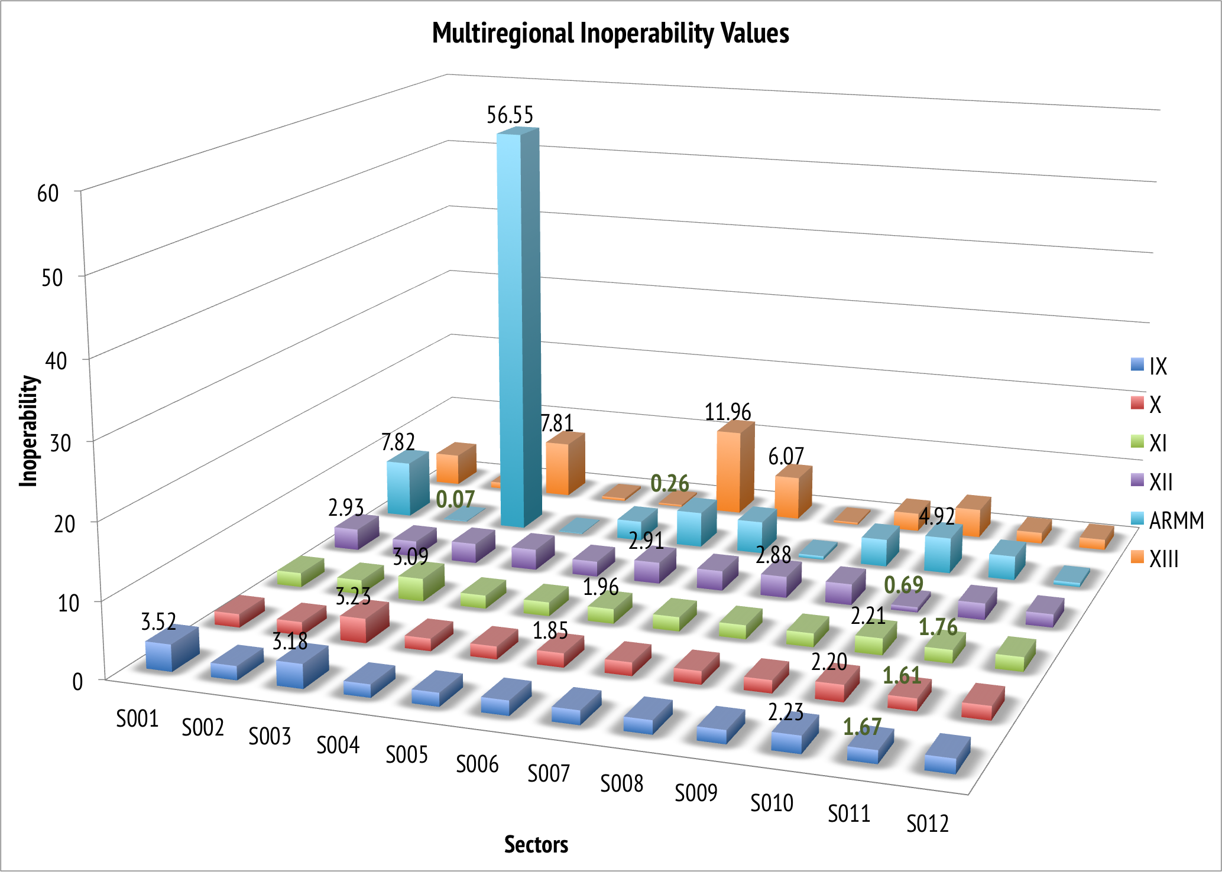
Case Study Simulation Results
Figure 1. Multiregional Inoperability Input-Output Results for an initial 10% inoperability in the electricity sector of Region XII: SOCCSKSARGEN

Slide 15
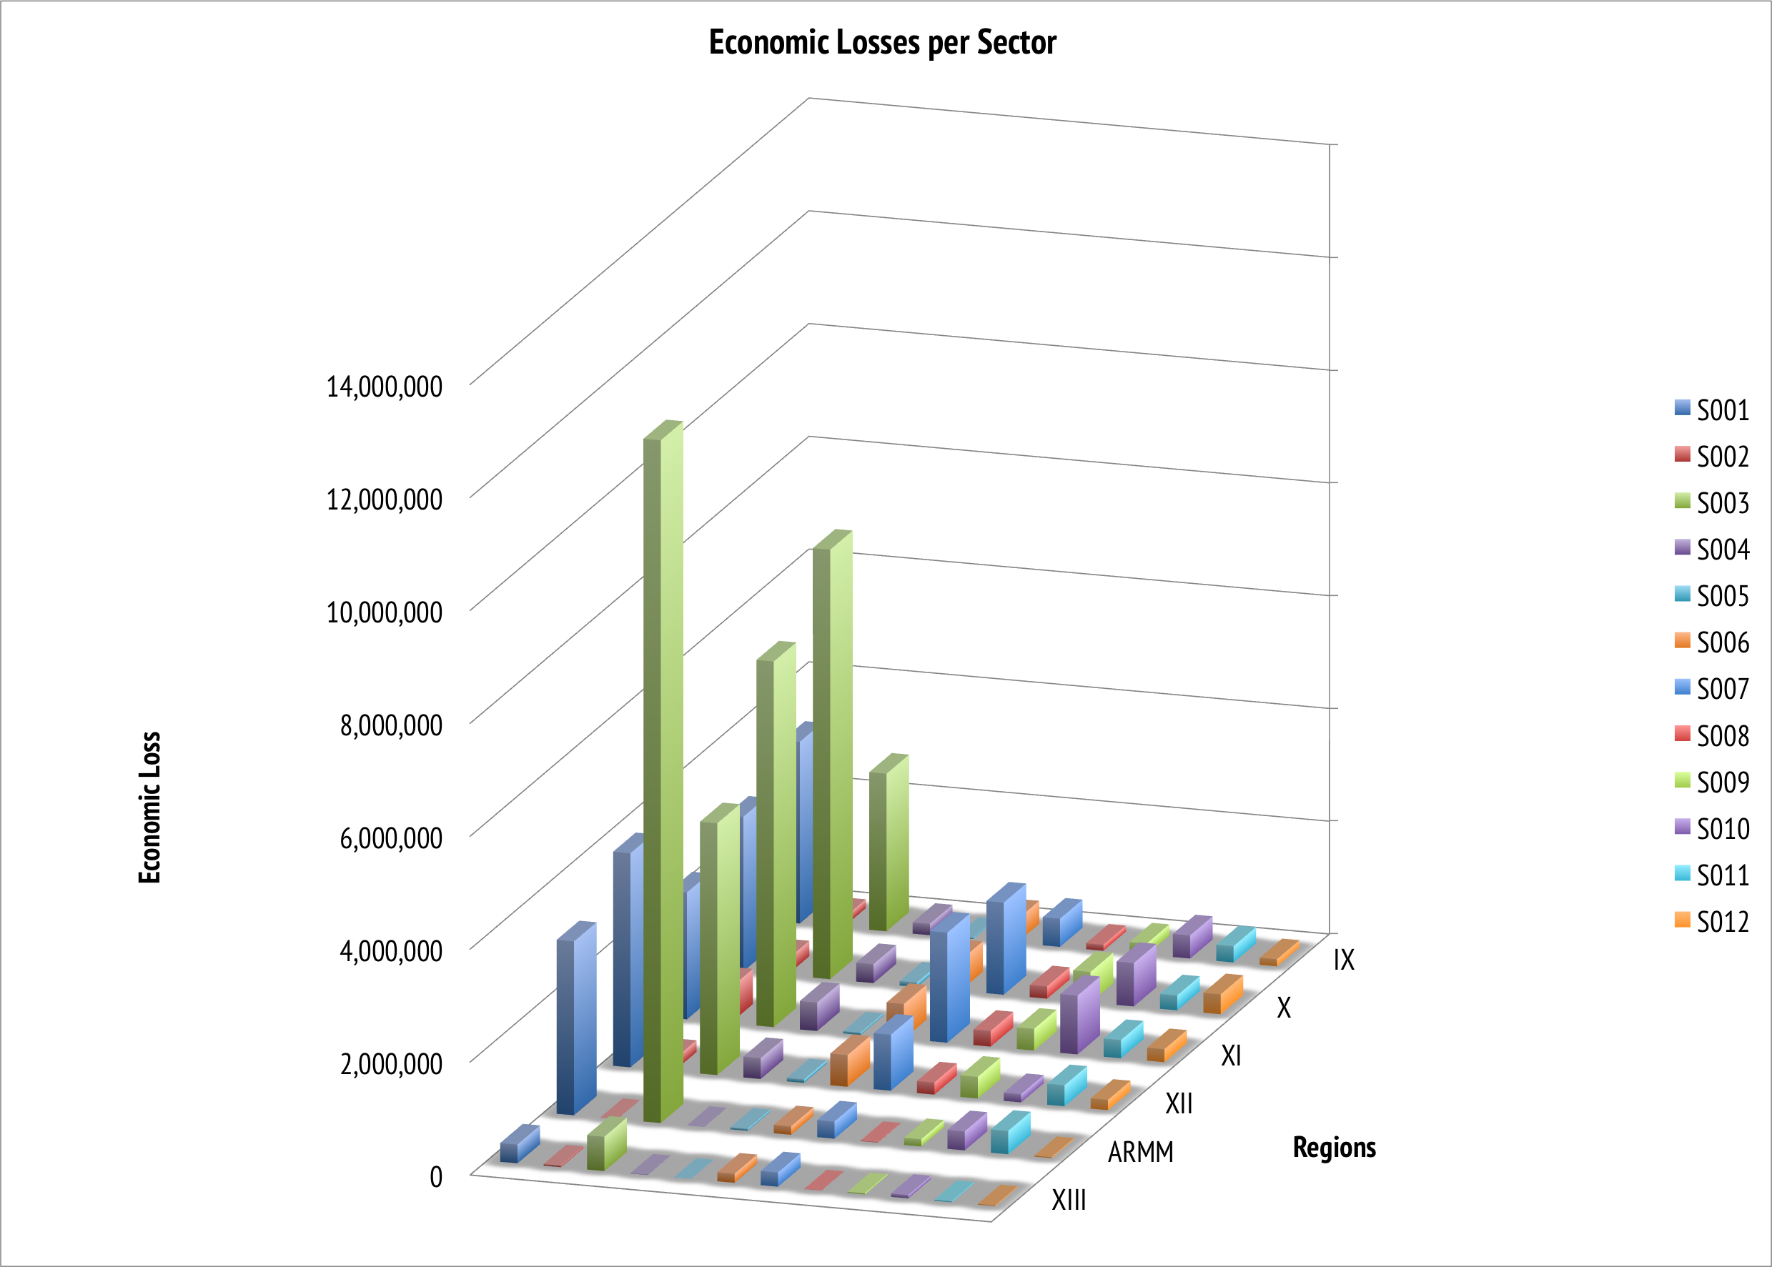
Case Study Simulation Results
Figure 2a. Economic Losses per Industry due to an initial inoperability of 10% to the electricity sector of Region XII: SOCCSKSARGEN

Slide 16
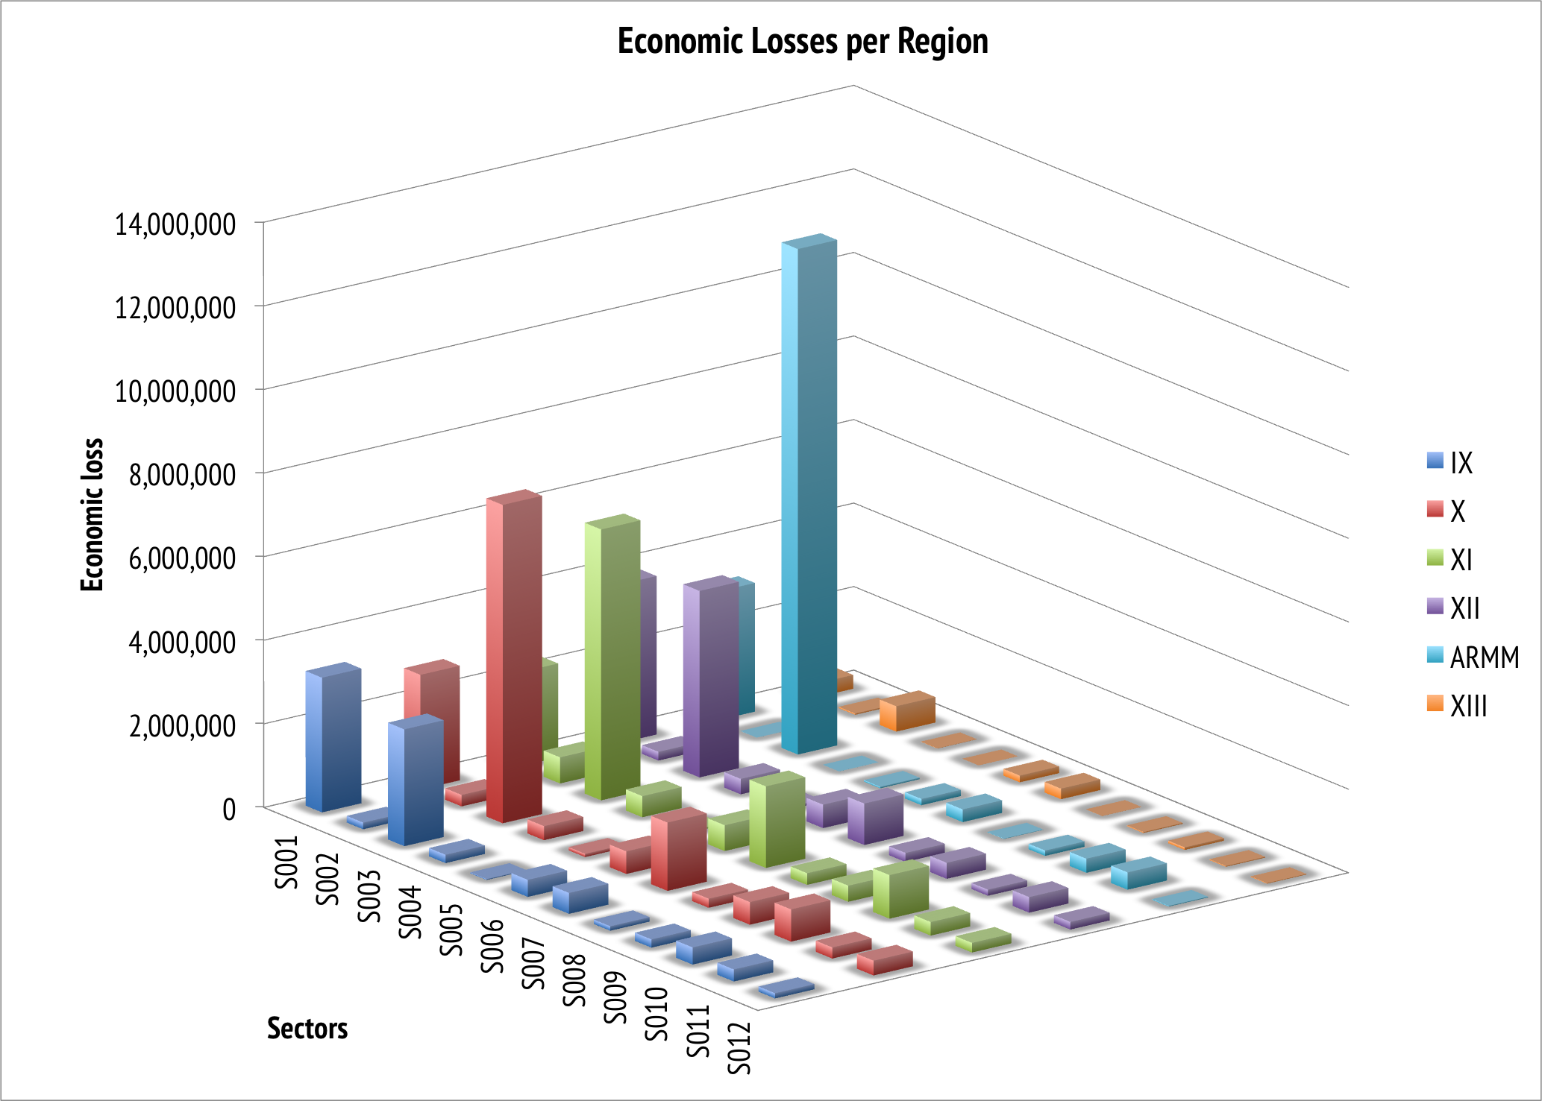
Case Study Simulation Results
Figure 2b. Economic Losses per Region due to an initial inoperability of 10% to the electricity sector of Region XII: SOCCSKSARGEN

Slide 17
Case Study Simulation Results: Sensitivity Analysis
In order to illustrate sensitivity to changes, inoperability values are generated for scenarios where initial inoperability of 5% and 15% for the electricity sector of Region XII are considered.
To assess the Mindanao power crisis, the analysis is limited to regions of Mindanao namely Regions IX to XIII and ARMM.

Slide 18
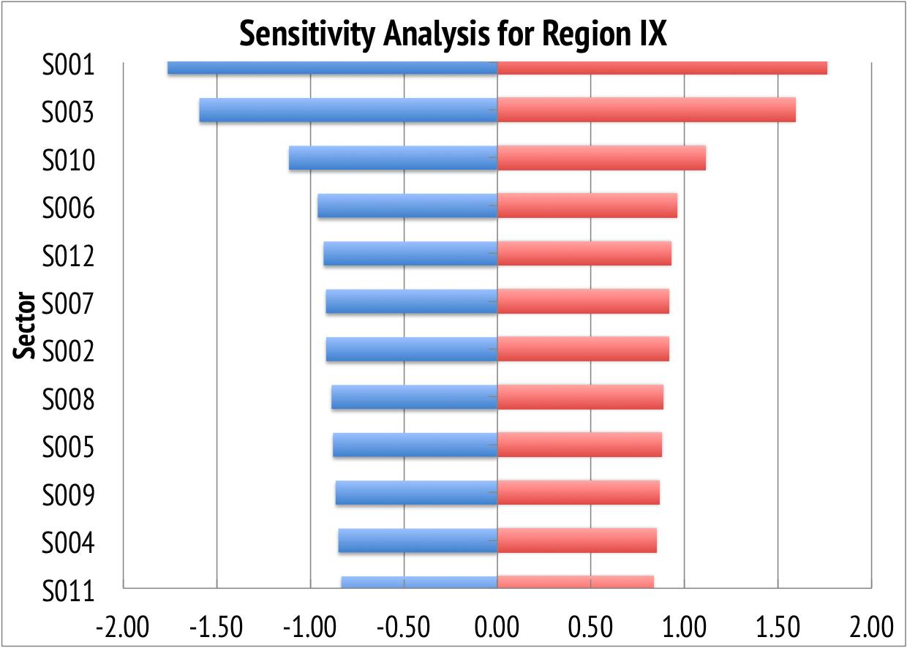
Case Study Simulation Results: Sensitivity Analysis
Figure 3a. Sensitivity analysis for Inoperability in Region IX given inoperability in the electricity sector in Region XII

Slide 19
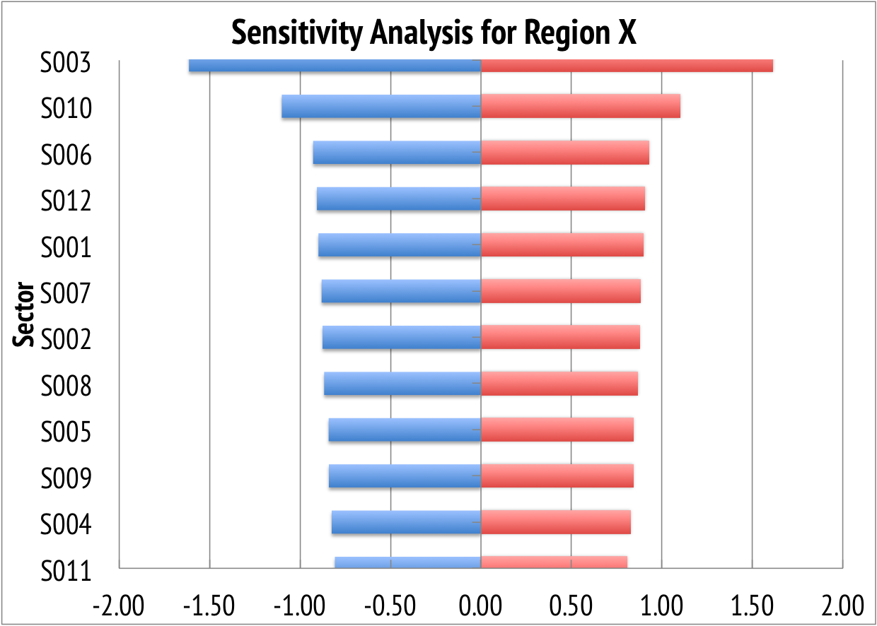
Case Study Simulation Results: Sensitivity Analysis
Figure 3b. Sensitivity analysis for Inoperability in Region X given inoperability in the electricity sector in Region XII

Slide 20
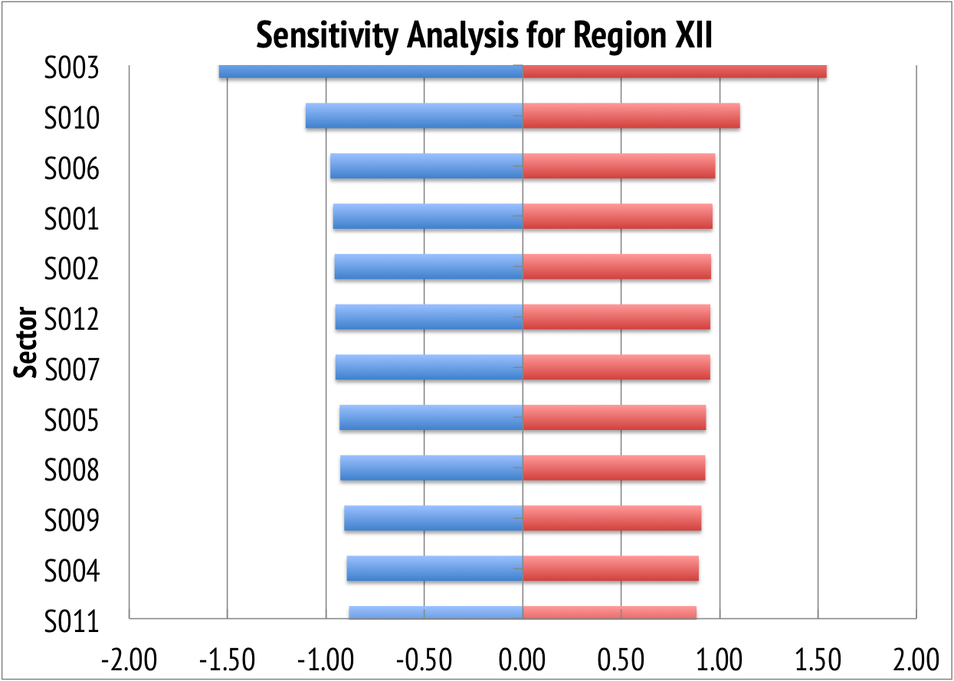
Case Study Simulation Results: Sensitivity Analysis
Figure 3c. Sensitivity analysis for Inoperability in Region XI given inoperability in the electricity sector in Region XII

Slide 21
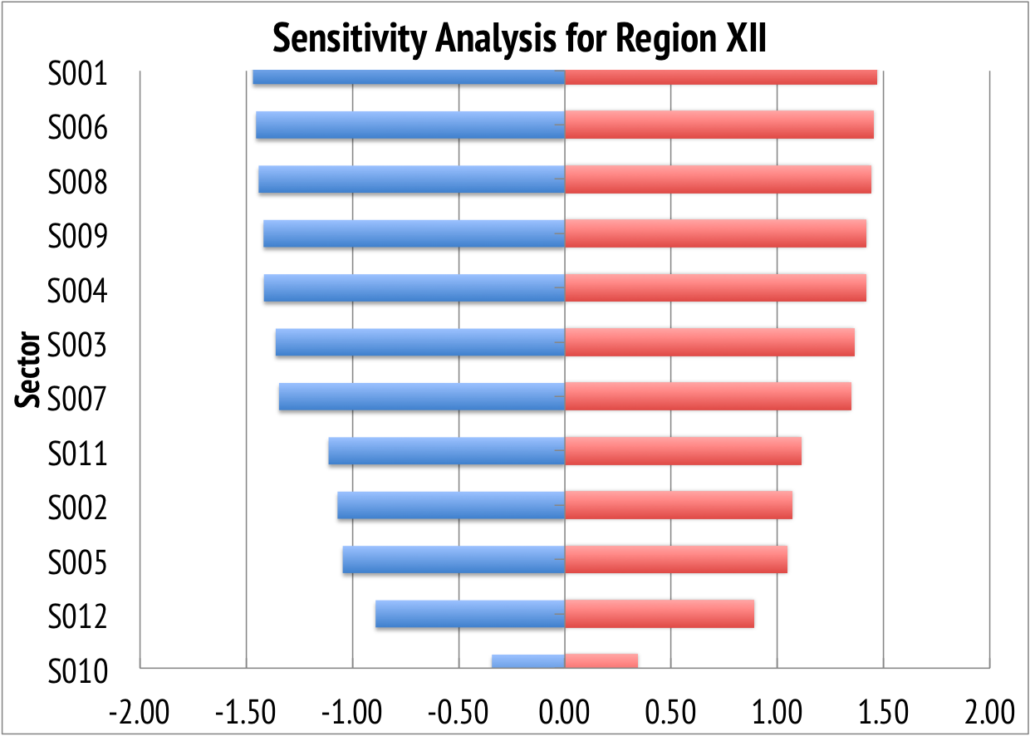
Case Study Simulation Results: Sensitivity Analysis
Figure 3d. Sensitivity analysis for Inoperability in Region XII given inoperability in the electricity sector in Region XII

Slide 22
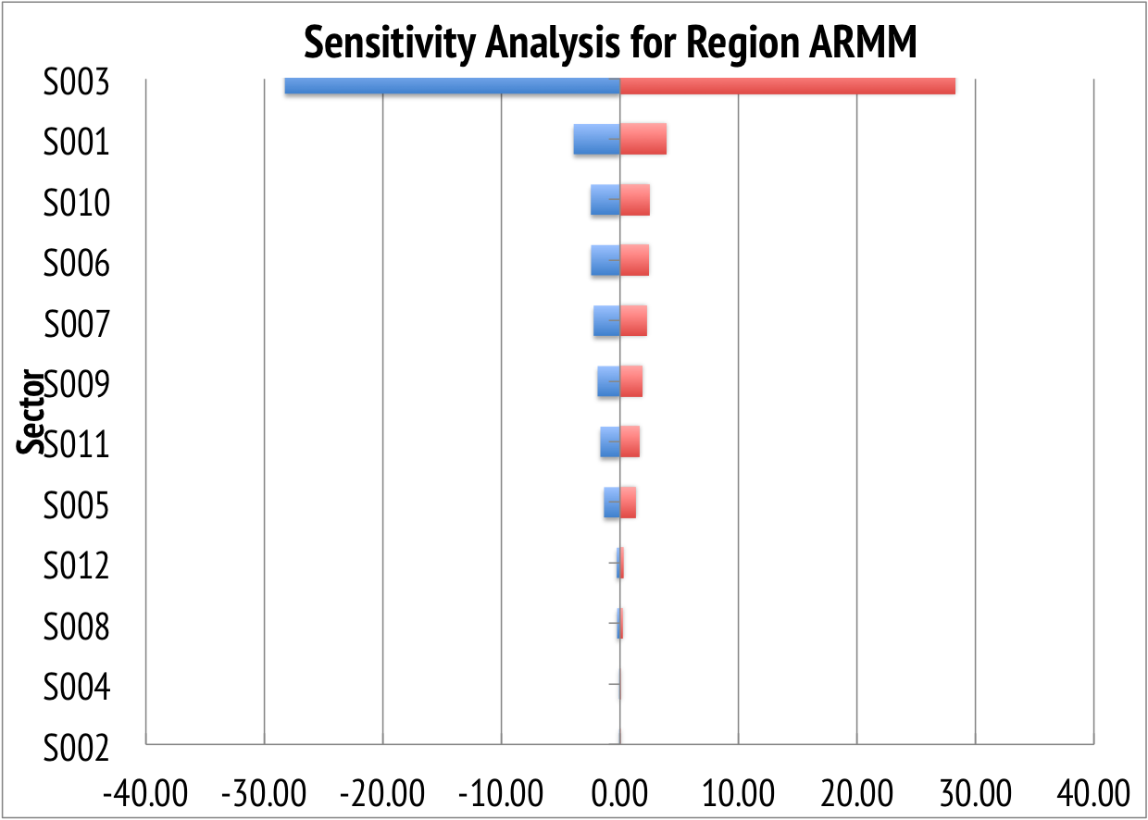
Case Study Simulation Results: Sensitivity Analysis
Figure 3e. Sensitivity analysis for Inoperability in ARMM given inoperability in the electricity sector in Region XII

Slide 23
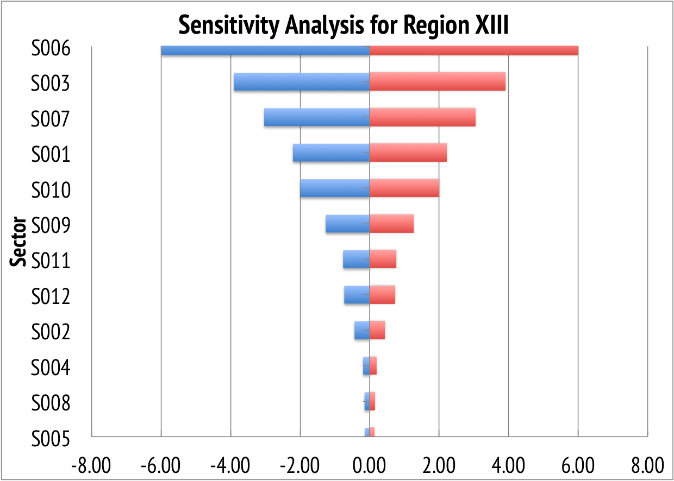
Case Study Simulation Results: Sensitivity Analysis
Figure 3f. Sensitivity analysis for Inoperability in Region XIII given inoperability in the electricity sector in Region XII

Slide 24
Conclusion: Inoperability and Economic Loss
ARMM relies heavily on other regions for trading activities.
The manufacturing sector is highly dependent on the electricity sector as it exhibits the highest level of inoperability and economic losses.
Agriculture, fishery and forestry, finance, transportation, communication and storage, and private services also suffer from significant levels of inoperability due to perturbations in the electricity sector while agriculture and trade trail closely to manufacturing in terms of economic losses.
The region with the highest economic loss is ARMM while Region X and XI follows closely as an effect of geographic proximity to Region XII.

Slide 25
Conclusion: Sensitivity Analysis
Sensitivity analysis shows manufacturing, agriculture, fishery and forestry, and transportation, communication and storage as sectors most sensitive to an inoperability in the electricity sector. These sectors should then have high priorities for disaster risk management caused by power outages.
In contrast, sensitivity analysis shows that government services, mining and quarrying, and construction are sectors should be low priorities for disaster risk management due to power disruptions.

Slide 26
Areas for Future Research
Utilization of alternate methods for estimating the trade coefficients
Implement optimization methods to properly allocate resources in light of a perturbation

Slide 27
Sources
Crowther, K.G. and Haimes, Y.Y. (2010). Development of the multiregional inoperability input-output model (MRIIM) for spatial explicitness in preparedness of interdependent regions. Systems Engineering. 13(1). pp. 28-46.
Haimes, Y. Y. & Jiang, P. (2001). Leontief-based model of risk in complex interconnected infrastructures. Journal of System. 7(1). pp. 1-12.
Haimes, Y.Y. (2009). Risk modeling, assessment, and management. Wiley, New York.
Isard, W. (1960). Methods of regional analysis. MIT Press.
Isard, W. et al. (1998). Methods of interregional and regional analysis. Ashgate, Brookfield, VT.
Leontief, W. and Strout, A. (1963). Multiregional input-output analysis.
Miller, R.E. and Blair, P.D. (2009). Input-output analysis: Foundations and extensions. Prentice-Hall, Englewood Cliffs, NJ.
Santos, J.R. and Haimes, Y.Y. (2004). Modeling the demand reduction input-output inoperability

Slide 28
Thank you
francesca_solis@dlsu.edu.ph

